Slide 1
Mjukvaruutveckling - Lösningsförslag
Daniel linden & Johannes Sörensen

Slide 2
Howto: variabel
private String adress;
Åtkomstmodifierare
Klasstyp (eller variabeltyp)
Namn

Slide 3
Howto: metod
public String getAdress() {
return adress;
}
public void setAdress(String adress) {
this.adress = adress;
}
Åtkomstmodifierare
Returtyp (void betyder: ingen returtyp)
Namn
Inparametrar

Slide 4
Howto: implementera en klass
public class Person {
private String adress;
}

Slide 5
Howto: åtkomstmetoder
private String adress;
public String getAdress() {
return adress;
}
public void setAdress(String adress) {
this.adress = adress;
}

Slide 6
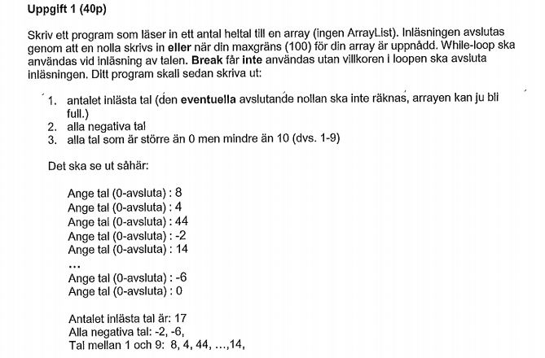
Augusti 2014 – Uppg1

Slide 7
Augusti 2014 – Uppg 1
package uppgift1;
import java.util.Scanner;
public class Uppgift1 {
public static void main(String [] args){
int [] listOfNumbers = new int[100];
Scanner scan = new Scanner(System.in);
int index = 0;
System.out.println("Skriv in ett tal!");
int input = scan.nextInt();
while(input != 0 && index <100){
listOfNumbers[index] = input;
System.out.println("Skriv in ett tal!");
input = scan.nextInt();
index++;
}

Slide 8
Augusti 2014 – Uppg 1
If(index == 100){
Index ++;
}
System.out.println("Antal inlästa tal: " + (index-1));

Slide 9
Augusti 2014 – Uppg 1
System.out.print("Alla negativa tal: ");
for(int loop = 0; loop < index; loop++){
if(listOfNumbers[loop] < 0){
System.out.print(listOfNumbers[loop] + ", ");
}
}

Slide 10
Augusti 2014 – Uppg 1
System.out.print("Tal mellan 1 och 9: ");
for(int loop = 0; loop < index; loop++){
if(listOfNumbers[loop] > 0 && listOfNumbers[loop] < 10){
System.out.print(listOfNumbers[loop] + ", ");
}
}

Slide 11
package uppgift1;
import java.util.Scanner;
public class Uppgift1 {
public static void main(String [] args){
int [] listOfNumbers = new int[100];
Scanner scan = new Scanner(System.in);
int index = 0;
System.out.println("Skriv in ett tal!");
int input = scan.nextInt();
while(input != 0 && index <100){
listOfNumbers[index] = input;
System.out.println("Skriv in ett tal!");
input = scan.nextInt();
index++;
}
System.out.println("Antal inlästa tal: " + (index-1));
System.out.print("Alla negativa tal: ");
for(int loop = 0; loop < index; loop++){
if(listOfNumbers[loop] < 0){
System.out.print(listOfNumbers[loop] + ", ");
}
}
System.out.println();
System.out.print("Tal mellan 1 och 9: ");
for(int loop = 0; loop < index; loop++){
if(listOfNumbers[loop] > 0 && listOfNumbers[loop] < 10){
System.out.print(listOfNumbers[loop] + ", ");
}
}
}
}

Slide 12
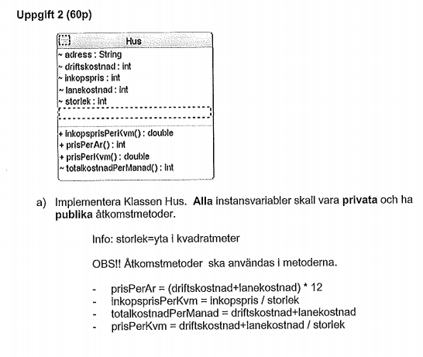
Augusti 2014 – Uppg 2a

Slide 13
Augusti 2014 – Uppg 2a
package uppgift2;
public class Hus {
private String adress;
private int driftskostnad;
private int inkopspris;
private int lanekostnad;
private int storlek;

Slide 14
Augusti 2014 – Uppg 2a
public String getAdress() {
return adress;
}
public void setAdress(String adress) {
this.adress = adress;
}
public int getDriftskostnad() {
return driftskostnad;
}
public void setDriftskostnad(int driftskostnad) {
this.driftskostnad = driftskostnad;
}
public int getInkopspris() {
return inkopspris;
}
public void setInkopspris(int inkopspris) {
this.inkopspris = inkopspris;
}
public int getLanekostnad() {
return lanekostnad;
}
public void setLanekostnad(int lanekostnad) {
this.lanekostnad = lanekostnad;
}
public int getStorlek() {
return storlek;
}
public void setStorlek(int storlek) {
this.storlek = storlek;
}

Slide 15
Augusti 2014 – Uppg 2a
public double inkopsprisPerKvm(){
return inkopspris / storlek;
}
public int prisPerAr(){
return (driftskostnad + lanekostnad) * 12;
}
public double prisPerKvm(){
return (driftskostnad + lanekostnad) /storlek;
}
public int totalkostnadPerManad(){
return driftskostnad + lanekostnad;
}

Slide 16
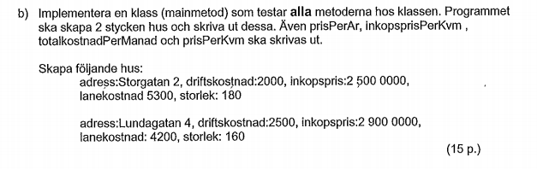
Augusti 2014 – Uppg 2b

Slide 17
Augusti 2014 – Uppg 2b
package uppgift2;
import java.util.ArrayList;
public class Test {
public static void main (String [] args){
Hus husEtt = new Hus();
husEtt.setAdress("Storgatan 2");
husEtt.setDriftskostnad(2000);
husEtt.setInkopspris(25000000);
husEtt.setLanekostnad(5300);
husEtt.setStorlek(180);
Hus husTva = new Hus();
husTva.setAdress("Lundagatan 4");
husTva.setDriftskostnad(2500);
husTva.setInkopspris(29000000);
husTva.setLanekostnad(4200);
husTva.setStorlek(160);

Slide 18
Augusti 2014 – Uppg 2b
System.out.println("Test hus 1:");
System.out.println("getAddress: " + husEtt.getAdress());
System.out.println("getDriftskostnad: " + husEtt.getDriftskostnad());
System.out.println("getInkopspris: " + husEtt.getInkopspris());
System.out.println("getLanekostnad: " + husEtt.getLanekostnad());
System.out.println("getStorlek: " + husEtt.getStorlek());
System.out.println("--------------------");
System.out.println("Pris per år: " + husEtt.prisPerAr());
System.out.println("Inköpspris per kvm: " + husEtt.inkopsprisPerKvm());
System.out.println("Totalkostnad per månad: " + husEtt.totalkostnadPerManad());
System.out.println("Pris per kvadratmeter: " + husEtt.prisPerKvm());
System.out.println("--------------------");

Slide 19
Augusti 2014 – Uppg 2b
System.out.println("Test hus 2:");
System.out.println("getAddress: " + husTva.getAdress());
System.out.println("getDriftskostnad: " + husTva.getDriftskostnad());
System.out.println("getInkopspris: " + husTva.getInkopspris());
System.out.println("getLanekostnad: " + husTva.getLanekostnad());
System.out.println("getStorlek: " + husTva.getStorlek());
System.out.println("--------------------");
System.out.println("Pris per år: " + husTva.prisPerAr());
System.out.println("Inköpspris per kvm: " + husTva.inkopsprisPerKvm());
System.out.println("Totalkostnad per månad: " + husTva.totalkostnadPerManad());
System.out.println("Pris per kvadratmeter: " + husTva.prisPerKvm());
System.out.println("--------------------");

Slide 20

Augusti 2014 – Uppg 2c

Slide 21
Augusti 2014 – Uppg 2c
/*
* Uppgift C
*/
ArrayList<Hus> listaMedHus = new ArrayList<Hus>();
listaMedHus.add(husEtt);
listaMedHus.add(husTva);
int summa = 0;
//for each
for(Hus h : listaMedHus){
summa += h.getLanekostnad();
}
////for
//for(int i=0; i< listaMedHus.size(); i++){
//Hus h = listaMedHus.get(i);
//summa += h.getLanekostnad();
//}
System.out.println("Total lånekostnad: " + summa);

Slide 22
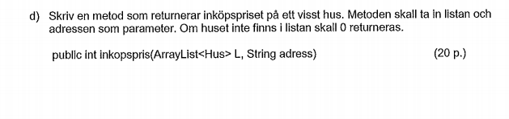
Augusti 2014 – Uppg 2d

Slide 23
Augusti 2014 – Uppg 2d
/*
* Uppgift D
*/
public int inkopsPris(ArrayList<Hus> L, String adress){
//for each
for(Hus h : L){
if(h.getAdress().equals(adress)){
return h.getInkopspris();
}
}
////for
//for(int i = 0; i< L.size(); i++){
//Hus h = L.get(i);
//if(h.getAdress().equals(adress)){
//return h.getInkopspris();
//}
//}
return 0;
}

Slide 24
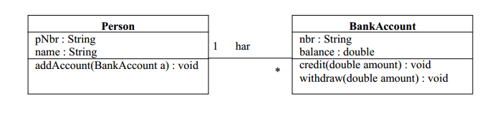
Labb 5

Slide 25
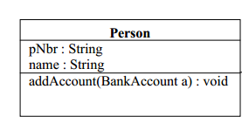
Labb 5
public class Person {
private String pNbr;
private String name;
private List<BankAccount> bankAccountList;
public String getpNbr() {
return pNbr;
}
public void setpNbr(String pNbr) {
this.pNbr = pNbr;
}
public String getName() {
return name;
}
public void setName(String name) {
this.name = name;
}
public List<BankAccount> getBankAccountList() {
return bankAccountList;
}
public void setBankAccountList(List<BankAccount> bankAccountList) {
this.bankAccountList = bankAccountList;
}
public void addAccount(BankAccount a) {
bankAccountList.add(a);
}
}

Slide 26
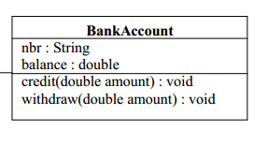
Labb 5
package labb5;
public class BankAccount {
private String nbr;
private double balance;
private Person owner;
public Person getOwner() {
return owner;
}
public void setOwner(Person owner) {
this.owner = owner;
}
public String getNbr() {
return nbr;
}
public void setNbr(String nbr) {
this.nbr = nbr;
}
public double getBalance() {
return balance;
}
public void setBalance(double balance) {
this.balance = balance;
}
public void credit(double amount) {
balance += amount;
}
public void withdraw(double amount) {
balance -= amount;
}
}

Slide 27
Labb 5
package labb5;
import java.util.ArrayList;
public class Main {
public static void main(String[] args) {
Person p = new Person();
p.setpNbr("2");
p.setName("Daniel");
BankAccount a1 = new BankAccount();
BankAccount a2 = new BankAccount();
a1.setOwner(p);
a2.setOwner(p);
p.addAccount(a1);
p.addAccount(a2);
}
}

Slide 28
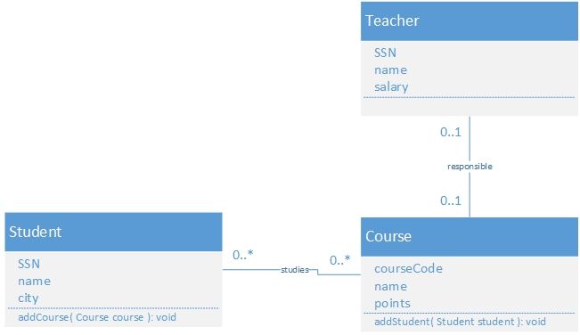
Mer komplexa relationer

Slide 29
package exampleModel;
public class Teacher {
private String SSN;
private String name;
private double salary;
private Course responsibleForCourse;
public String getSSN() {
return SSN;
}
public void setSSN(String sSN) {
SSN = sSN;
}
public String getName() {
return name;
}
public void setName(String name) {
this.name = name;
}
public double getSalary() {
return salary;
}
public void setSalary(double salary) {
this.salary = salary;
}
public Course getResponsibleForCourse() {
return responsibleForCourse;
}
public void setResponsibleForCourse(Course responsibleForCourse) {
this.responsibleForCourse = responsibleForCourse;
}
}

Slide 30
package exampleModel;
import java.util.ArrayList;
public class Student {
private String SSN;
private String name;
private String city;
private ArrayList<Course> studyingCourses = new ArrayList<Course>();
public String getSSN() {
return SSN;
}
public void setSSN(String sSN) {
SSN = sSN;
}
public String getName() {
return name;
}
public void setName(String name) {
this.name = name;
}
public String getCity() {
return city;
}
public void setCity(String city) {
this.city = city;
}
public ArrayList<Course> getStudyingCourses() {
return studyingCourses;
}
public void setStudyingCourses(ArrayList<Course> studyingCourses) {
this.studyingCourses = studyingCourses;
}
public void addCourse(Course course) {
this.getStudyingCourses().add(course);
}
}

Slide 31
package exampleModel;
import java.util.ArrayList;
public class Course {
private String courseCode;
private String name;
private double points;
private Teacher responsibleTeacher;
private ArrayList<Student> studentsOnCourse = new ArrayList<Student>();
public String getCourseCode() {
return courseCode;
}
public void setCourseCode(String courseCode) {
this.courseCode = courseCode;
}
public String getName() {
return name;
}
public void setName(String name) {
this.name = name;
}
public double getPoints() {
return points;
}
public void setPoints(double points) {
this.points = points;
}
public Teacher getResponsibleTeacher() {
return responsibleTeacher;
}
public void setResponsibleTeacher(Teacher responsibleTeacher) {
this.responsibleTeacher = responsibleTeacher;
}
public ArrayList<Student> getStudentsOnCourse() {
return studentsOnCourse;
}
public void setStudentsOnCourse(ArrayList<Student> studentsOnCourse) {
this.studentsOnCourse = studentsOnCourse;
}
public void addStudent(Student student) {
this.getStudentsOnCourse().add(student);
}
}

Slide 32
package exampleModel;
public class Main {
public static void main(String[] args) {
// Creates a teacher
Teacher t = new Teacher();
t.setSSN("1");
t.setName("Mats");
t.setSalary(35000);
// Creates a course
Course c = new Course();
c.setName("Mjukvaruutveckling");
c.setCourseCode("K1");
c.setResponsibleTeacher(t);
t.setResponsibleForCourse(c);
// Creates a student
Student s1 = new Student();
s1.setSSN("1");
s1.setName("Daniel");
s1.setCity("Lund");
s1.addCourse(c);
c.addStudent(s1);
// Creates another student
Student s2 = new Student();
s2.setSSN("2");
s2.setName("Johannes");
s2.setCity("Lund");
s2.addCourse(c);
c.addStudent(s2);
System.out.println("Kurs");
System.out.println("Kurskod: " + c.getCourseCode() + "\tKursnamn: " + c.getName());
System.out.println("\tAnsvarig lärare");
System.out.println("\tSSN: " + c.getResponsibleTeacher().getSSN() + "\tNamn: ” + c.getResponsibleTeacher().getName() + "\tLön: " + c.getResponsibleTeacher().getSalary());
System.out.println("\nRegistrerade studenter (for each)");
for (Student s : c.getStudentsOnCourse()) {
System.out.println("\tSSN: " + s.getSSN() + "\tNamn: " + s.getName() + "\tStad: " + s.getCity());
}
System.out.println("\nRegistrerade studenter (for)");
for (int i = 0; i < c.getStudentsOnCourse().size(); i++) {
Student s = c.getStudentsOnCourse().get(i);
System.out.println("\tSSN: " + s.getSSN() + "\tNamn: " + s.getName() + "\tStad: " + s.getCity());
}
}
}

Slide 33
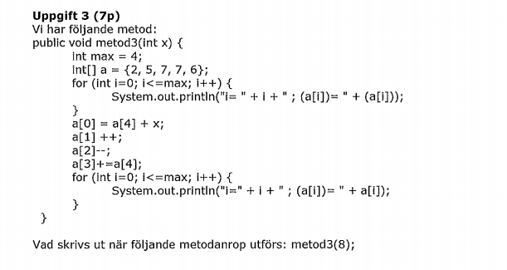
Vad fan gör programmet????1

Slide 34

Vad fan gör programmet????1
i= 0 ; (a[i])= 2
i= 1 ; (a[i])= 5
i= 2 ; (a[i])= 7
i= 3 ; (a[i])= 7
i= 4 ; (a[i])= 6

Slide 35

Vad fan gör programmet????1
a[0] = 2
a[1] = 5
a[2] = 7
a[3] = 7
a[4] = 6
12
6
6
13
[”Hipp”, ”Hipp"]
SEN SKRIVER DEN UT SAMMA SAK

